Slide 1
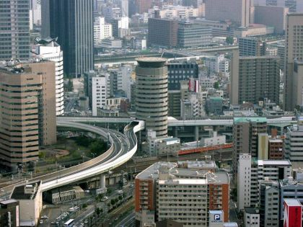
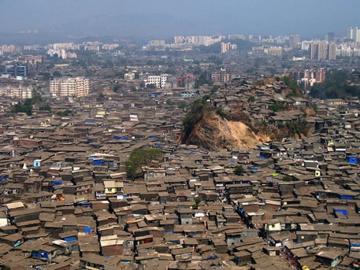
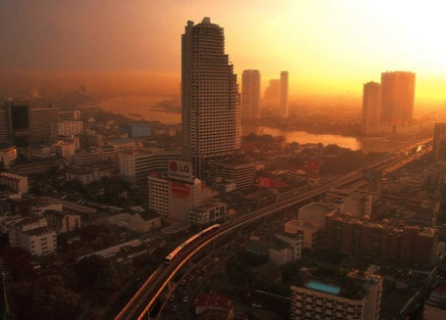
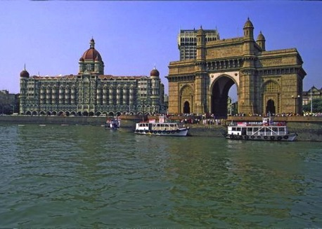

Slide 2
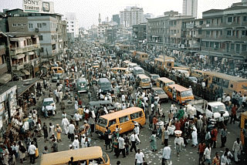
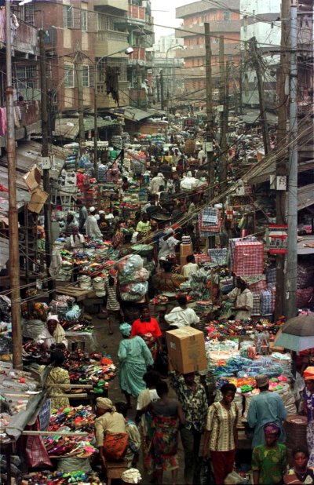
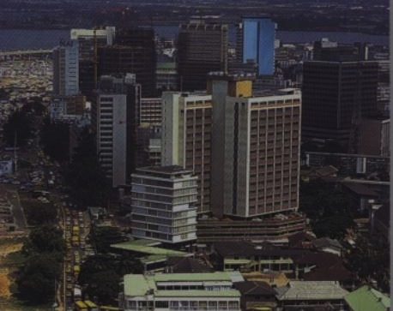

Slide 3
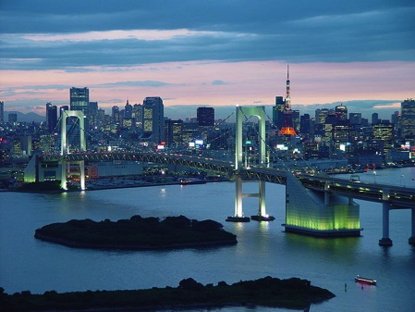
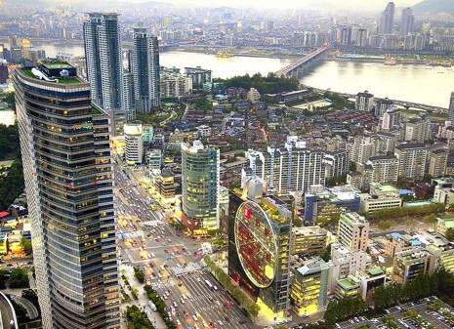
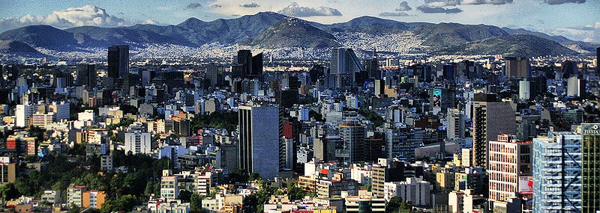

Slide 4
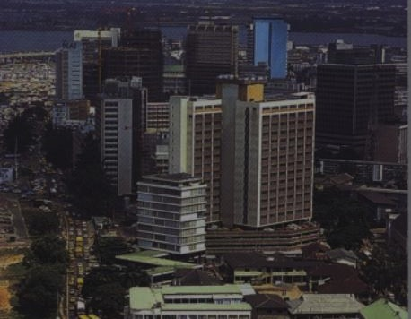

Slide 5
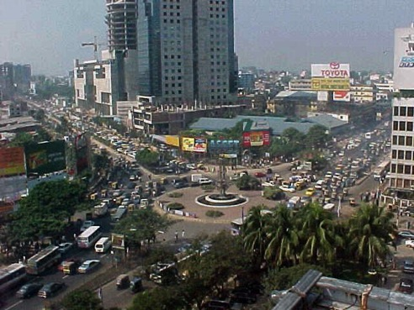
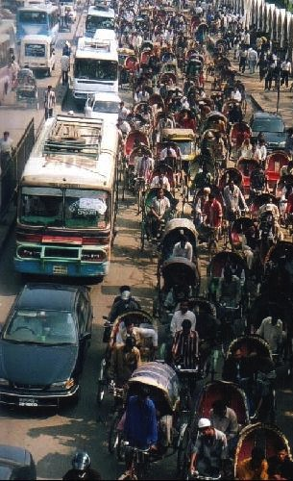
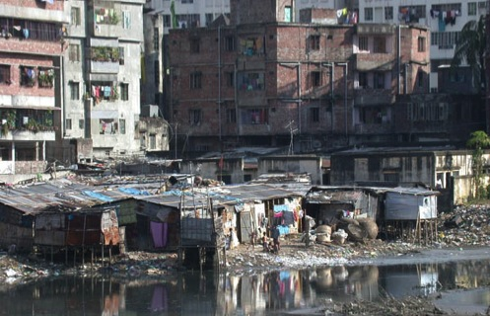

Slide 6
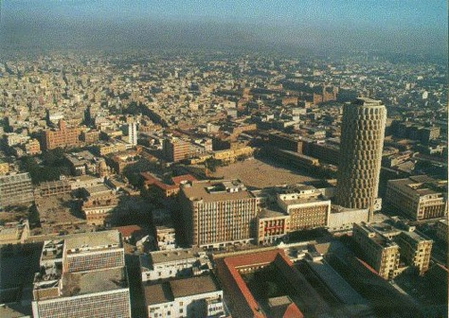
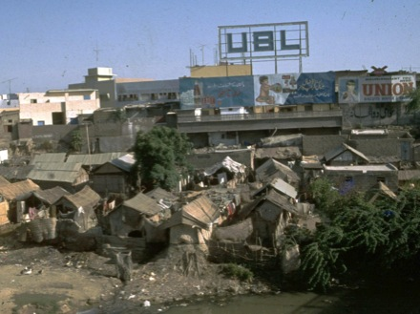
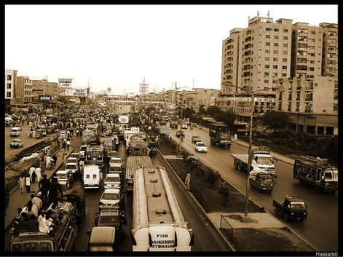
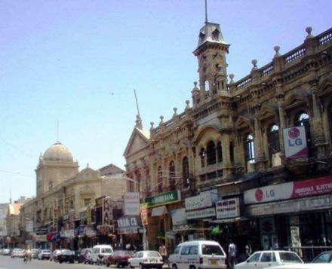

Slide 7
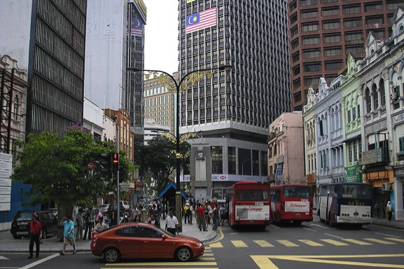
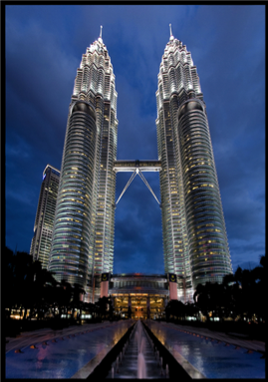

Slide 8
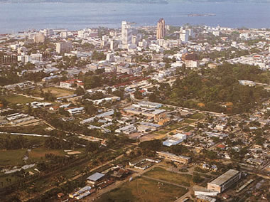
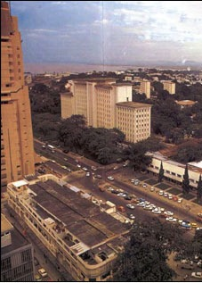
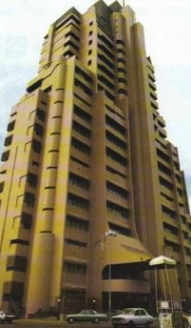
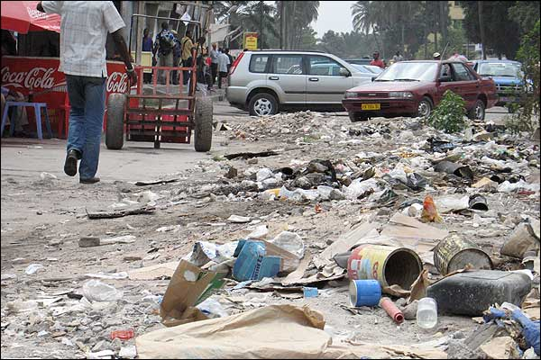
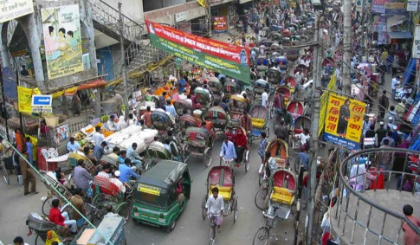

Slide 9
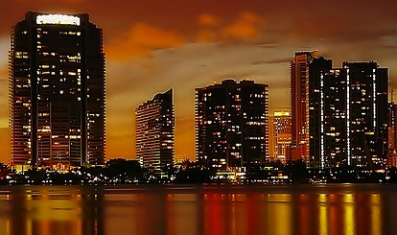
A Tale of [a Few] Cities
Notes:
Today, more than half of the world’s population resides in cities, but this has been a relatively recent development – historically speaking. In 1800, only 3% of the worlds population was urban; and by 1900 there were only a dozen cities with a population over 1 million citizens – today there are more than 400 … Of course, not all cities are created equal; Some are extremely modern – symbols of our current levels of sophistication …And others are not so much …

Slide 10
Unit Breakdown
Development of cities over time
Urban models (internal structure; mostly in US)
Urban Hierarchies (where and why they are located where they are)
Urban trends in the US and global core
Urban development in the periphery

Slide 11
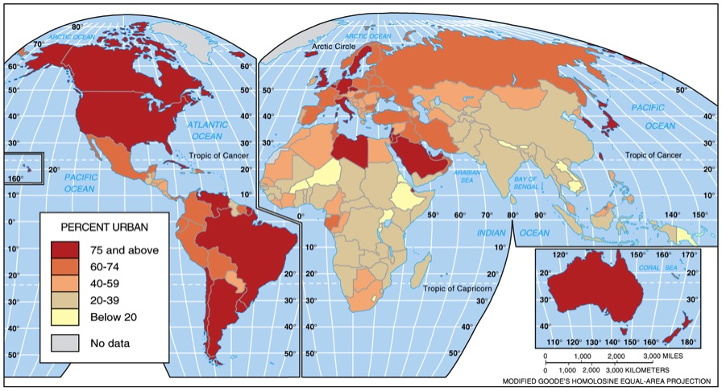
City – a conglomeration of people and buildings clustered together to serve as a center of politics, culture, and economics.
Urban - the [central] city and the surrounding environs (suburbs) connected to the city.

Slide 12
Today, more than half of the world’s population resides in cities,
but this has been a relatively recent development – historically speaking.
In 1800, only 3% of the worlds population was urban;
and by 1900 there were only a dozen cities with a population over 1 million citizens –
today there are more than 400 …
Of course, not all cities are created equal;
Some are extremely modern – symbols of our current levels of sophistication …
And others are not so much …

Slide 13
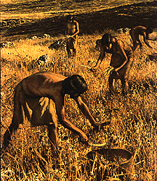
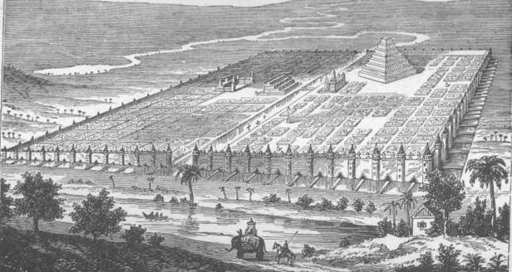
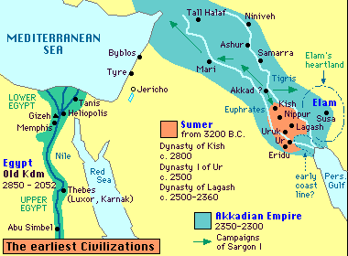
Ancient Cities & Civilizations (1st Urb. Rev.)
Urbanism – process in which cities grow
Urban = walled
Egalitarian societies
Babylon
Early city-states
Notes:
Ancient Cities & Civilizations; Urbanism – process in which cities grow; urban/rural distinction = walls; Egalitarian societies – persisted after 1st Agricultural Revolution … regardless the First Urban Revolution began around 8,000 years ago – likely in the Fertile Crescent – the same region in which Mesopotamia developed the great city of Babylon in the 2nd century BC … First cities – based on non-primary activity: Primary = extractive sector (farming, mining, fishing, logging,…); Secondary = manufacturing sector (assembly line; hand-crafted,…); Tertiary = service sector (teacher, doctor, lawyer, politician, scientist,…); Increased functional specialization – leads to states (at least 3 levels of administration)

Slide 14
Ancient Cities & Civilizations
Urbanism – process in which cities grow; urban/rural distinction = walls
Egalitarian societies – persisted after 1st Agricultural Revolution … regardless the First Urban Revolution began around 8,000 years ago – likely in the Fertile Crescent – the same region in which Mesopotamia developed the great city of Babylon in the 2nd century BC …
First cities – based on non-primary activity:
Primary = extractive sector (farming, mining, fishing, logging,…)
Secondary = manufacturing sector (assembly line; hand-crafted,…)
Tertiary = service sector (teacher, doctor, lawyer, politician, scientist,…)
Increased functional specialization – leads to states (at least 3 levels of administration)

Slide 15
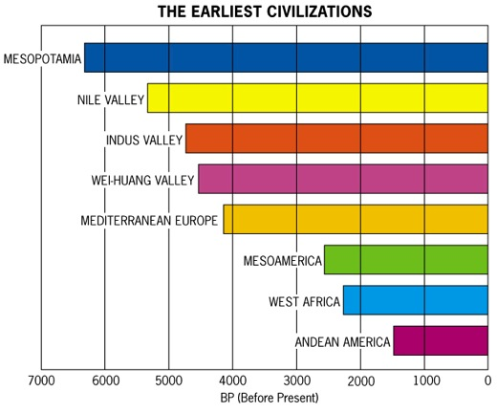
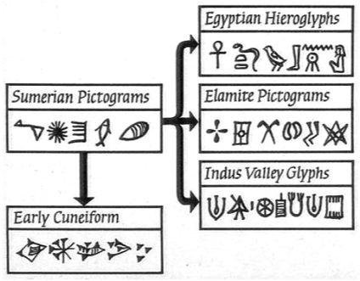
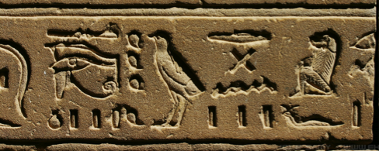
Formative Era (7,000 – 5,000 B.C.) – states & urbanization
Stratified societies
Urban elite →
Government
Writing, laws, …
Notes:
Formative Era (7,000 – 5,000 B.C.) – development of states & urbanization; Stratified societies – hierarchy of social classes (e.g. urban elite – decision makers who controlled resources & lives; these thinkers and leaders were likely the ones to develop government, writing, record keeping, and the establishment of codified laws)

Slide 16
Formative Era (7,000 – 5,000 B.C.) – development of states & urbanization
Stratified societies – hierarchy of social classes (e.g. urban elite – decision makers who controlled resources & lives; these thinkers and leaders were likely the ones to develop government, writing, record keeping, and the establishment of codified laws)

Slide 17
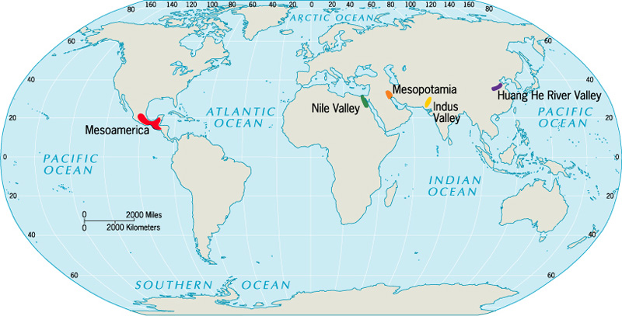
Five Hearths of Urbanization
Agricultural surplus + social stratification = cities

Slide 18
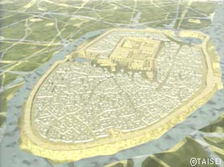
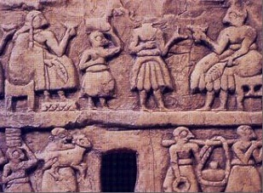
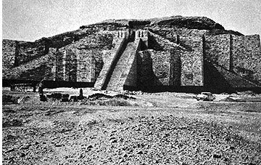
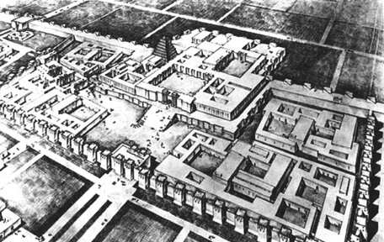
Mesopotamia
Poorest on the outskirts
Disease kept pop. small
10-15k per city
Ur
Narrow lanes
No waste disposal
Ziggurat at Ur
Notes:
This image is a reconstruction of the ancient city of Ur, established around 2100 B.C. as the capital of the Mesopotamian Civilization, which arose about 3500 B.C. The people of this civilization built a wonderful city, which was centered on a temple called a ziggrat that towered above all other buildings. Cities protected by walls; Temples (ziggurats) dominated landscape (often built on mounds); Poorest on outskirts, narrow lanes b/w homes; No waste disposal (dumped garbage in streets); Disease kept pop. small (10-15,000 max)

Slide 19
Mesopotamia
Cities protected by walls
Temples (ziggurats) dominated landscape (often built on mounds)
Poorest on outskirts, narrow lanes b/w homes
No waste disposal (dumped garbage in streets)
Disease kept pop. small (10-15,000 max)

Slide 20
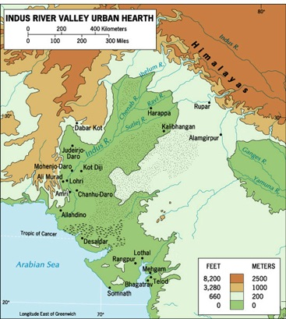
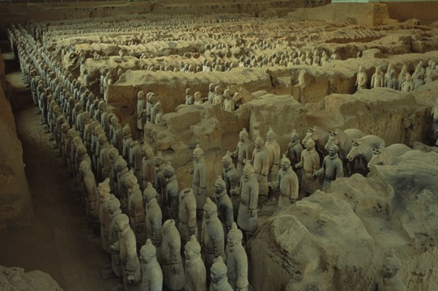
Indus River Valley
Huang He and Wei River Valleys
Terracotta Warriors guarding the tomb of the Chinese Emperor Qin Xi Huang

Slide 21
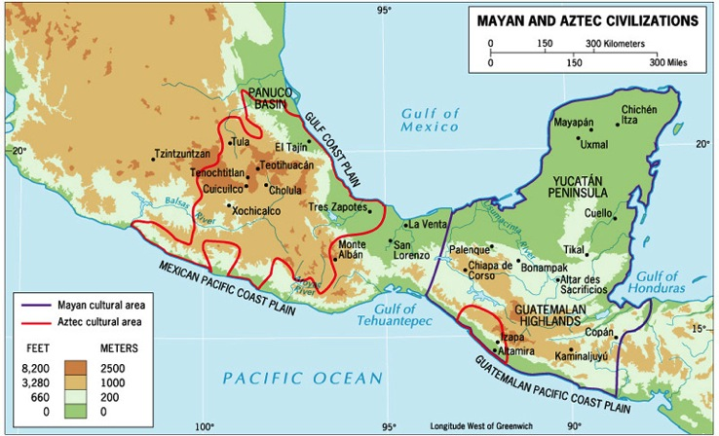
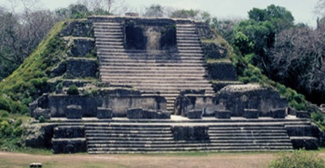
Mesoamerica
Mayan and Aztec Civilizations

Slide 22
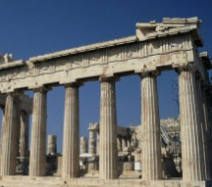
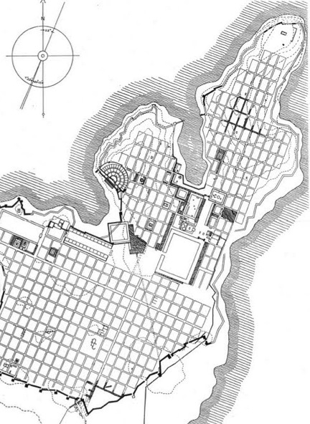
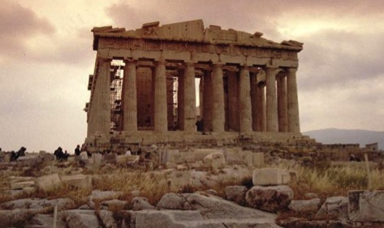
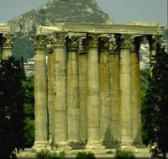
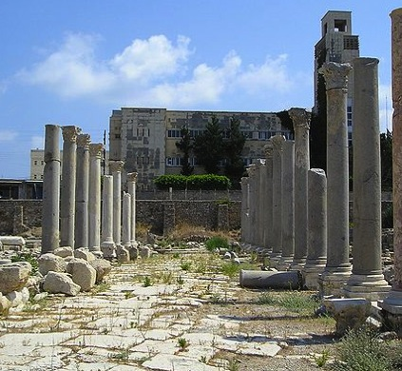
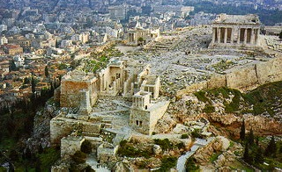
Greece
worldwide impact (e.g. affected W. Eur.)
Grid system
Acropolis (Parthenon)
Poor housing
No sanitation
Agora
Miletus (494 BC)
Notes:
Greece had worldwide impact (e.g. affected W. Eur.); Acropolis (best structures built on high point of city; Parthenon); Agora (“market”; public spaces in lower point w/ steps – debated, lectured…); Grid system (streets & alleys); Housing & sanitation no better than Mesopotamia

Slide 23
Greece
Had worldwide impact (e.g. affected W. Eur.)
Acropolis (best structures built on high point of city; Parthenon)
Agora (“market”; public spaces in lower point w/ steps – debated, lectured…)
Grid system (streets & alleys)
Housing & sanitation no better than Mesopotamia

Slide 24
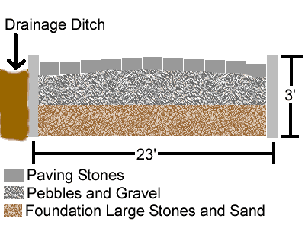
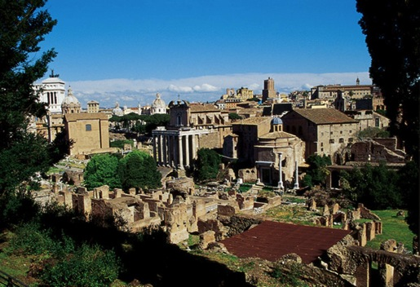
Rome
Paved road
Transportation network
Forum
Coliseum
Notes:
Rome: Transportation networks (linked urban places by road, river & sea); Used rectangular grid pattern (Greek); Forum (market – Greek); Coliseum (expanded from Greek theater); In this map you can see the vast distribution of cities in the western provinces of the Roman Empire c. 100 AD; Collapse of Rome coincided w/ disintegration of urban system & transport networks

Slide 25
Rome
Transportation networks (linked urban places by road, river & sea)
Used rectangular grid pattern (Greek)
Forum (market – Greek)
Coliseum (expanded from Greek theater)
In this map you can see the vast distribution of cities in the western provinces of the Roman Empire c. 100 AD
Collapse of Rome coincided w/ disintegration of urban system & transport networks

Slide 26
What urban public space is depicted?

Slide 27
Notes:
Distribution of cities in the western provinces of the Roman Empire c. 100

Slide 29
Collapse of Rome coincided w/ disintegration of urban system & transport networks
Nimes Aqueduct, France
Acropolis, Rome

Slide 30
Preindustrial Europe
Notes:
Preindustrial Europe – “Medieval Optimum” (warmer climate expanded farmlands, aided Europe’s recovery & defeat of the Moors)

Slide 31
Urban Banana (pre – Eur. colonization)
Notes:
Urban Banana (pre – Eur. Colonization); Crescent-shaped urban zone across Eurasia (from England to Japan); Cities developed along Silk Road, many cities located in interior (not coasts)

Slide 32
Notes:
Even in the 14th century, 80% to 90% of Europe's urban population was still inside the former borders of the Roman Empire.

Slide 33
Little Ice Age
Notes:
“Little Ice Age” (14th – 17th c., colder & drier climate forced farmers & peasants to cities)

Slide 34
Preindustrial Europe – “Medieval Optimum” (warmer climate expanded farmlands, aided Europe’s recovery & defeat of the Moors)
Urban Banana (pre – Eur. colonization)
Crescent-shaped urban zone across Eurasia (from England to Japan)
Cities developed along Silk Road, many cities located in interior (not coasts)
Even in the 14th century, 80% to 90% of Europe's urban population was still inside the former borders of the Roman Empire.
“Little Ice Age” (14th – 17th c., colder & drier climate forced farmers & peasants to cities)

Slide 35
Mercantile cities
Venice
Liverpool
Lisbon
London
Amsterdam
Notes:
Boats In The Port Of London, a painting by Claude Oscar Monet. Mercantile cities (e.g. Lisbon, Amsterdam, London, Liverpool, …); Maritime trade disrupted trade routes & centers of power starting in the 1500s (from interior to coastal ports); Central square became focus (“downtown”); These cities became nodes of a network of trade

Slide 36
Mercantile cities (e.g. Lisbon, Amsterdam, London, Liverpool, …)
Maritime trade disrupted trade routes & centers of power starting in the 1500s (from interior to coastal ports)
Central square became focus (“downtown”)
These cities became nodes of a network of trade

Slide 37
During the mercantile era, the cities that thrived were embellished by wealthy merchant families, who built ornate mansions, patronized the arts, participated in city governments, and supported the reconstruction of city centers.
Genoa, Italy

Slide 38
The Second Urban Revolution
2nd Agr. Rev. = (↑ food/surplus; pop. → cities )
Ind. Rev. = (↑ cities near resources)

Slide 39
Second Urban Revolution
People → cities (manufacturing)
Made possible by:
2nd Agr. Rev. (↑ food production & surplus)
Ind. Rev. (↑ growth of cities near resources)

Slide 40
Manufacturing Cities
London
Belfast
Chicago
Notes:
Manufacturing cities; Grew out of Ind. Rev. and “Little Ice Age”; Mushrooming populations – fed the factories with cheap labor, but led to the development of tenements – or low-class apartment complexes often located just outside the central city, … and with new technologies like railroads, these urban realms were connected in ways that were impossible previously … The poor living & health conditions improved w/ gov’t intervention, city planning, and laws such as zoning – in which city land was reserved specifically for residential, commercial, or industrial use …

Slide 41
Manufacturing cities
Grew out of Ind. Rev. and “Little Ice Age”
Mushrooming populations – fed the factories with cheap labor, but led to the development of tenements – or low-class apartment complexes often located just outside the central city, … and with new technologies like railroads, these urban realms were connected in ways that were impossible previously …
The poor living & health conditions improved w/ gov’t intervention, city planning, and laws such as zoning – in which city land was reserved specifically for residential, commercial, or industrial use …

Slide 42
Modern Cities
Kuala Lumpur
New York City
Miami
Sydney
Beijing
Notes:
Modern cities – Have developed out of today’s transportation & road systems – which have allowed the dispersal of vast populations into the suburbs in many cases …
… postmodernism – architecture & design developed for look & commerce (disjointed from historical roots)

Slide 43
Modern cities –
Have developed out of today’s transportation & road systems – which have allowed the dispersal of vast populations into the suburbs in many cases …
… postmodernism – architecture & design developed for look & commerce (disjointed from historical roots)

Slide 44
Urban Models

Slide 45
Berlin, Germany (with wall)
Urban Morphology
The layout of a city, its physical form and structure.
Berlin, Germany (without wall

Slide 46
Urban Morphology
Layout of a city (form & structure)
Functional Zonation
Division of the city into regions (zones) for certain purposes (functions)
Cairo, Egypt, CBD
Notes:
CBD = commercial & often the geographic heart of a city (the main downtown area)

Slide 47
Central City = (CBD + older housing)
Cairo, Egypt, Central city
Suburb = (outside central city)
Tradeoff b/w land value & distance
Cairo, Egypt, housing projects

Slide 48
Bid-rent (land-rent) Curve
Price and demand for real estate changes as the distance from the CBD increases

Slide 49
Bid-rent (land-rent) Curve

Slide 50
Land Economics

Slide 52
Land rent (bid rent) may increase, but land value decreases
Land rent (bid rent) may increase

Slide 53
Models – based on competing land uses
Typical density profile of a North American city

Slide 54
Similar assumptions … (von Thünen)
Flat land
Centrality
Maximize profits
Transportation
Single market
Ernest Burgess
1920s Chicago
Notes:
Concentric Zone Model; Ernest Burgess (1920s); Chicago: Similar assumptions to von Thunen … 1) Isotropic flat plain (uniform surface; featureless); 2) Importance of centrality (accessibility to the market – in this case the CBD); 3) Individuals seek to ⬆ profits & ⬇ costs; 4) Transportation costs = proportional to distance in all directions (concentric rings); 5) Single market (CBD); “isolated state”

Slide 55
Zone 1 = CBD
1
Notes:
1) CBD (In NYC – Manhattan’s daytime population is more than half the nighttime pop.)

Slide 56
Zone 2 ≈ factories
2
Notes:
2) Zone of transition (res. deterioration & light ind.)

Slide 57
Zone 3 ≈ lower class
3
Notes:
3) Blue-collar workers

Slide 58
Zone 4 ≈ middle class
4
Notes:
4) Middle-class

Slide 59
Zone 5 ≈ upper class
5
Notes:
5) Suburbs (white collar)

Slide 60
The city is dynamic: as it grows … inner rings affect outer ones

Slide 61
Concentric Zone Model
Ernest Burgess (1920s); Chicago:
Similar assumptions to von Thunen …
1) Isotropic flat plain (uniform surface; featureless)
2) Importance of centrality (accessibility to the market – in this case the CBD)
3) Individuals seek to ⬆ profits & ⬇ costs
4) Transportation costs = proportional to distance in all directions (concentric rings)
5) Single market (CBD); “isolated state”
Zones – 1) CBD (In NYC – Manhattan’s daytime population is more than half the nighttime pop.); 2) Zone of transition (res. deterioration & light ind.); 3) Blue-collar workers; 4) Middle-class; 5) Suburbs (white collar)
Dynamic: inner rings encroach the outer ones

Slide 62
Chicago in the 1920s

Slide 63
Chicago
Zoning

Slide 64
Streetcar (New Haven CT; 1940)
1939
Homer Hoyt
Notes:
Sector Model; Homer Hoyt (1939); criticized Burgess Model as too simple & inaccurate; Growth creates a pie-shaped urban structure; connected to land-rent; Zones could extend from the CBD to the outer edge (3) … low-rent areas … The same is true w/ high-rent, transportation, and industry; What made this possible was the streetcar (self-powered light rail vehicles – often powered by electricity)

Slide 65
Sector Model
Homer Hoyt (1939); criticized Burgess Model as too simple & inaccurate
Growth creates a pie-shaped urban structure; connected to land-rent
Zones could extend from the CBD to the outer edge (3) … low-rent areas …
The same is true w/ high-rent, transportation, and industry
What made this possible was the streetcar (self-powered light rail vehicles – often powered by electricity)

Slide 66
Sectors, more than zones, would = value

Slide 67
Urban Models

Slide 68
1920s
1939

Slide 69
Harris
Ullman
1945
Notes:
Multiple Nuclei Model; Chauncy Harris & Edward Ullman (1945); neither of two models are accurate; CBD was losing its dominant position as the nucleus of the urban area … several nodes of growth; Separate nuclei become specialized … not located in relation to any distance attribute
The Effect of the Car … Car dependence (not only in the US); Fragmentation of activities and the dispersal of amenities (urban sprawl); The car is a comfortable place, making travel less of a burden (greater commutes)

Slide 70
Multiple Nuclei Model
Chauncy Harris & Edward Ullman (1945); neither of two models are accurate
CBD was losing its dominant position as the nucleus of the urban area … several nodes of growth
Separate nuclei become specialized …
… not located in relation to any distance attribute
The Effect of the Car
Car dependence (not only in the US)
Fragmentation of activities and the dispersal of amenities (urban sprawl)
The car is a comfortable place, making travel less of a burden (greater commutes)

Slide 72
Suburbanization
Riverside, IL
(1st planned community in US)
Notes:
Riverside is arguably the first planned community in the United States, designed in 1869 by Frederick Law Olmsted (who also designed Central Park, NYC). The village was incorporated in 1875. This was part of the garden city movement. Suburbs … are residential areas, either existing as part of a city (Australia & New Zealand), or as a separate residential community within commuting distance of a city (US & Canada) … suburbs contain mostly middle & upper class residents; Although suburbanization mostly occurred in the US after WWII the first planned community was in Riverside, IL in 1869 (by the same man who designed Central Park in NYC) … today more than half of US citizens live in the suburbs (its the only country in the world structured like this)

Slide 73
Exurbs – (extra-urban) “commuter zones”
Located outside Wash D.C.
Loudon County, VA
Located outside Houston
The Woodlands, TX
Notes:
Exurbs … are rings of prosperous communities beyond the suburbs that are commuter towns for an urban area. Exurbs vary in size, but may be composed of smaller neighborhoods to larger towns or cities. Often, the residents are relatively wealthy with higher levels of education than the average suburbanite.

Slide 74
Weston, FL (exurb?)

Slide 75
As cities became more complex and transport technology improved & became more affordable … people were more able to move away from the cities where there was greater space, and closer to amenities like parks or lakes
Suburbs … are residential areas, either existing as part of a city (Australia & New Zealand), or as a separate residential community within commuting distance of a city (US & Canada) … suburbs contain mostly middle & upper class residents
Although suburbanization mostly occurred in the US after WWII the first planned community was in Riverside, IL in 1869 (by the same man who designed Central Park in NYC) … today more than half of US citizens live in the suburbs (its the only country in the world structured like this)
Exurbs … are rings of prosperous communities beyond the suburbs that are commuter towns for an urban area. Exurbs vary in size, but may be composed of smaller neighborhoods to larger towns or cities. Often, the residents are relatively wealthy with higher levels of education than the average suburbanite.

Slide 76
Urban/ Suburban Sprawl
Henderson, NV
Boca Raton, FL
Milton, Ontario
Phoenix, AZ
Notes:
Urban/ Suburban Sprawl - outward spreading of a city and its suburbs … usually associated with the unrestricted growth of residential, commercial & transportation zones (sprawl is usually seen as a wasteful and inefficient result of suburbanization)

Slide 78
Infill
Lancaster, UK
Lawrence, KS
Columbus, OH
Notes:
Infill - In contrast to the occurrence of sprawl, is the opposite push for cities to develop infill … In an urban sense, infill is the use of land within a city or suburban area for further construction. In cities, it focuses on the reuse and repositioning of obsolete or underutilized buildings and sites. Infill buildings are constructed on vacant or underutilized property or between existing buildings …for example, the buildings in the center of the image from Lancaster – were built on what was an open area … Suburban infill is virtually the same thing, only the focus is on filling in unused spaces – to reduce sprawl

Slide 79
Urban/ Suburban Sprawl
outward spreading of a city and its suburbs
… usually associated with the unrestricted growth of residential, commercial & transportation zones (sprawl is usually seen as a wasteful and inefficient result of suburbanization)
Infill
In contrast to the occurrence of sprawl, is the opposite push for cities to develop infill …
In an urban sense, infill is the use of land within a city or suburban area for further construction. In cities, it focuses on the reuse and repositioning of obsolete or underutilized buildings and sites. Infill buildings are constructed on vacant or underutilized property or between existing buildings …for example, the buildings in the center of the image from Lancaster – were built on what was an open area …
Suburban infill is virtually the same thing, only the focus is on filling in unused spaces – to reduce sprawl

Slide 80
Peripheral Model (Galactic City Model)
Notes:
Peripheral Model (Galactic City Model); Chauncy Harris (aka Edge City Model); which was an offshoot of the multiple nuclei model … as suburbs continue to sprawl, they spawn many suburban nucleations (or concentrations) … This urban decentralization leads to more downtowns and specialized corridors ... linked by a metropolitan expressway system (sometimes called a beltway); The model shows that the periphery is part of a functional metropolitan complex; not a series of separate CBDs; This is the reality of a post-industrial economy (where the bulk of people are working on tertiary economic activities more than secondary activities)

Slide 81
Peripheral Model (Galactic City Model)
Chauncy Harris (aka Edge City Model); which was an offshoot of the multiple nuclei model
… as suburbs continue to sprawl, they spawn many suburban nucleations (or concentrations) …
This urban decentralization leads to more downtowns and specialized corridors …
... linked by a metropolitan expressway system (sometimes called a beltway)
The model shows that the periphery is part of a functional metropolitan complex; not a series of separate CBDs
This is the reality of a post-industrial economy (where the bulk of people are working on tertiary economic activities more than secondary activities)

Slide 82
Office parks
Tend to be horizontal in shape — three to six stories tall
The use of the term “park” points to conscious anti-urban imagery
Many are surrounded by a well-landscaped outdoor space … human-made lakes and waterfalls, jogging paths, fitness trails, and picnic tables

Slide 83
James Vance (1964)
Criteria:
Terrain
Size
Economy
Transportation
Conurbations
Notes:
Urban Realms Model - James Vance (1964); Over time, the smaller villages, towns, and suburbs may grow to become more self-sufficient suburban sectors (focused on their own independent CBDs); Vance looked at San Francisco's urban ecology and summarize economic processes into a model … what formed were urban realms, conurbations (connected urban areas)
4 criteria shape the extent, character, & internal structure of each urban realm: 1) terrain (topography, water); 2) size of metropolis; 3) amount of economic activity (in each realm); 4) internal accessibility (transportation within each realm and between all realms)

Slide 84
Urban Realms Model
James Vance (1964)
Over time, the smaller villages, towns, and suburbs may grow to become more self-sufficient suburban sectors (focused on their own independent CBDs)
Vance – looked at San Francisco's urban ecology and summarize economic processes into a model … what formed were urban realms, conurbations (connected urban areas)
4 criteria shape the extent, character, & internal structure of each urban realm:
1) terrain (topography, water)
2) size of metropolis
3) amount of economic activity (in each realm)
4) internal accessibility (transportation within each realm and between all realms)

Slide 85
Edge Cities (Joel Garreau; 1991)
Office & retail space
Little residential
Trans. nodes
Not cities (1960s)
New Center, Detroit, MI
Miracle Mile, LA, CA
Notes:
Edge Cities (Joel Garreau; 1991); Extensive office & retail space (designed for car travel); Little residential space (↑ daytime / ↓ nighttime population); Near transportation nodes (e.g., airports, expressways); Not cities around the 1960s

Slide 86
Edge Cities of Philadelphia
Notes:
*
DISCUSSION:
* What are the elements required for a suburban area to be categorized as an "edge city"?

Slide 87
Edge Cities (Joel Garreau; 1991)
Extensive office & retail space (designed for car travel)
Little residential space (↑ daytime / ↓ nighttime population)
Near transportation nodes (e.g., airports, expressways)
Not cities around the 1960s

Slide 88
Edge Cities (three waves …)
Suburb of Portland, OR (1948)
Sunrise Shopping Center, Ft. Laud. (1960s)
suburbanization after WWII (homes → suburbs)
malling of US (markets → suburbs in ‘60s & ‘70s)
edge cities (jobs → suburbs in ‘80s & ‘90s)
Tyson’s Corner, VA (2010)

Slide 89
Types of Edge Cities
Waterfront, Pittsburg (built over a Carnegie Steel plant)
Tyson’s Corner, VA
Boomers (boomburgs/ boomburbs
Brownfield site
Richmond, California (hospital extension on a greyfield)
Reston Town Center, VA
Greenfields
Greyfield site
Notes:
Types of Edge Cities; Boomers (boomburgs/boomburbs): developed incrementally around a shopping mall or highway interchange; most common; Greenfields: previously undeveloped land … usually designed from the ground up & located on the suburban fringe … in contrast to brownfields (abandoned or underused industrial and commercial facilities) or greyfields (unused urban structures)

Slide 90
Types of Edge Cities
Tyson’s Corner, VA
Ballston, VA
Boomers (boomburgs/ boomburbs
Uptowns
Reston Town Center, VA
Historical marker
Greenfields
*examples from Northern Virginia
Notes:
Uptowns: built over an older and historic city or town …

Slide 91
Types of Edge Cities
Boomers (boomburgs/boomburbs): developed incrementally around a shopping mall or highway interchange; most common
Greenfields: previously undeveloped land … usually designed from the ground up & located on the suburban fringe
… in contrast to brownfields (abandoned or underused industrial and commercial facilities) or greyfields (unused urban structures)
Uptowns: built over an older and historic city or town …

Slide 92
Century City
Urban Realms (and Edge Cities) of Los Angeles
Notes:
“Suburbia” now a self-sufficient entity (edge cities); many are no longer an appendage to the central city (urban realms model).

Slide 93
Urban Hierarchies
Notes:
Paris, France; Urban hierarchies … why cities are of different sizes, & how they are arranged …

Slide 94
Situation
* relative location of a city
Site
* absolute location of a city
Notes:
Site: physical qualities of a place; valley, coastal plain, plateau, island,… Paris (first established on the Seine River), [Singapore (separation from Malaysia)] [a city’s location is often chosen for trade, defense, or religion]; Situation: position relative to other things … like travel routes, farmlands, manufacturing complexes, towns, cities (it’s near & distant surroundings); this is subject to change over time: [Chicago, Shenzhen (favorable), “Rust Belt” (unfavorable)] [a city’s place in the region and the world around it]

Slide 95
Urban hierarchies … why cities are of different sizes, & how they are arranged …
Site: physical qualities of a place; valley, coastal plain, plateau, island,… Paris (first established on the Seine River), [Singapore (separation from Malaysia)]
[a city’s location is often chosen for trade, defense, or religion]
Situation: position relative to other things … like travel routes, farmlands, manufacturing complexes, towns, cities (it’s near & distant surroundings); this is subject to change over time: [Chicago, Shenzhen (favorable), “Rust Belt” (unfavorable)]
[a city’s place in the region and the world around it]

Slide 96
Urban Function
Basic Sector – generates $
Non-basic Sector - service
Dependent on non-local
Dependent on local
Notes:
Urban Function; Basic sector – (manufacturing sector) made up of local businesses (firms) that produce goods for export and generates an inflow of $; manufacturing and resource-oriented firms (like logging or mining) are usually considered to be basic sector firms because their profits depend largely upon non-local factors (they usually export their goods); Non-basic sector – (service sector) composed of firms that depend largely upon local business conditions or are responsible for the functioning of the city itself (e.g. drycleaners, restaurants, grocery stores, local transit, schools, city gov’t,…)

Slide 97
Urban Function
Basic sector – (manufacturing sector) made up of local businesses (firms) that produce goods for export and generates an inflow of $; manufacturing and resource-oriented firms (like logging or mining) are usually considered to be basic sector firms because their profits depend largely upon non-local factors (they usually export their goods)
Non-basic sector – (service sector) composed of firms that depend largely upon local business conditions or are responsible for the functioning of the city itself (e.g. drycleaners, restaurants, grocery stores, local transit, schools, city gov’t,…)

Slide 98
Urban Function
Economic base theory
Multiplier effect
Functional specialization
Pittsburgh
Detroit
Notes:
Urban Function; A generalized representation of the proportion of the work force engaged in basic and non-basic activities by city size; as settlements become larger, a greater proportion of the work force is employed in non-basic activities; Larger centers are therefore more self-contained. Economic base theory = (economic base = ratio of basic to non-basic workers) the means of strengthening and growing the local economy is to develop and enhance the basic sector (the "engine" of the local economy); Multiplier effect – increases as a city grows (a new basic industry will create jobs in the non-basic sector, directly or indirectly); new workers demand goods & services … those who perform those services themselves demand even ore services (grocery clerk must also buy groceries …); but it also shows us that larger centers are more self-contained (possessing more of the basic needs and the amenities that people want); Functional specialization – Harris (1943); US cities were closely identified w/ certain products; As urban centers grow, they lose their functional specialization; rarely occurs today (e.g. Las Vegas – gambling; Vero Beach – retirement; Orlando - tourism)

Slide 99
Urban Function
Economic base theory = (economic base = ratio of basic to non-basic workers) the means of strengthening and growing the local economy is to develop and enhance the basic sector (the "engine" of the local economy)
Multiplier effect – increases as a city grows (a new basic industry will create jobs in the non-basic sector, directly or indirectly); new workers demand goods & services … those who perform those services themselves demand even ore services (grocery clerk must also buy groceries …); but it also shows us that larger centers are more self-contained (possessing more of the basic needs and the amenities that people want)
Functional specialization – Harris (1943); US cities were closely identified w/ certain products
As urban centers grow, they lose their functional specialization; rarely occurs today (e.g. Las Vegas – gambling; Vero Beach – retirement; Orlando - tourism)

Slide 100
Gravity Model
Waldo Tobler’s First Law of Geography - “Everything is related to everything else, but near things are more related than distant things.”
* Distance separates
Ft. Laud.
Miami
FTL = 160 K
MIA = 370 K
NYC = 8.0 M
NYC
Notes:
Gravity Model – mathematical prediction of the interaction between places; Waldo Tobler’s First Law of Geography - “Everything is related to everything else, but near things are more related than distant things.”; In mathematical terms: Interaction is proportional to the multiplication of the two populations divided by the distance between them squared
Spatial interaction (such as migration, traffic, phone calls, etc.) is directly related to the populations and inversely related to the distance between them

Slide 101
Gravity Model
Ft. Laud.
Miami
160 K
370 K
NYC
FTL – MIA = 26 mi. (I ≈ 88M)
FTL – NYC = 1,063 mi. (I ≈ 1.2M)
Interaction = 73X greater
8.0 M
Distance separates
Notes:
Migrants are less than 3% of the world’s population despite leaky borders

Slide 102
Gravity Model – mathematical prediction of the interaction between places
Waldo Tobler’s First Law of Geography - “Everything is related to everything else, but near things are more related than distant things.”
In mathematical terms: Interaction is proportional to the multiplication of the two populations divided by the distance between them squared
Spatial interaction (such as migration, traffic, phone calls, etc.) is directly related to the populations and inversely related to the distance between them
Ft. Lauderdale pop. = 160,000
Miami pop. = 370,000
NYC pop. = 8,000,000
Ft. Lauderdale to Miami = 26 mi. apart (I = 87,573,964)
Ft. Lauderdale to NYC = 1,063 mi. apart (I = 1,204,139)
Relative force of interaction is 73 times greater b/w FTL & MIA than FTL and NYC
So the reality is that some places have more pull than others, and this can be clearly seen with primate cities …
Notes:
Migrants are less than 3% of the world’s population despite leaky borders

Slide 103
Primate City
Country’s largest city & most expressive of national culture (may be the capital)
London
Paris
Buenos Aires
Cairo
* More than twice [the pop. of] the next largest city
Mexico City
Jefferson

Slide 104
Primate City
The leading city in its country or region, disproportionately larger than any others in the urban hierarchy.
The 'law of the primate city' was first proposed by Mark Jefferson in 1939. He defined a primate city as being "at least twice as large as the next largest city and more than twice as significant.”
A primate city is number one in its country in most aspects, like politics, economy, culture, education, etc.
Many states lack primate cities … mostly developed countries such as the United States, Germany, Canada, and Australia
Notes:
Primate City; The leading city in its country or region, disproportionately larger than any others in the urban hierarchy; The 'law of the primate city' was first proposed by Mark Jefferson in 1939. He defined a primate city as being "at least twice as large as the next largest city and more than twice as significant.”; A primate city is number one in its country in most aspects, like politics, economy, culture, education, etc. … Many states lack primate cities … mostly developed countries such as the United States, Germany, Canada, and Australia

Slide 105
Rank-Size Rule
Fibonacci Sequence
0, 1, 1, 2, 3, 5, 8, 13, 21, 34, …
0, 1, 1, 2, 3, 5, 8, 13, 21, 34, …
Notes:
From upper left clockwise: nautilus shell, sunflower, aloe, Whirlpool Galaxy, low pressure center over Iceland; Rank-Size Rule - occurs sometimes when a country does not have a dominant primate city (most LDCs = high degree of primacy); Follows a pattern similar to the Fibonacci Sequence, in which each successive number is equal to the sum of the two preceding numbers; This pattern can often be seen in nature … as with a sunflower, or aloe … And if you plot these numbers on a graph, a spiral forms which matches many other patterns we see in nature … whether it be a nautilus shell, a low pressure center, or even the Whirlpool Galaxy

Slide 106
Rank-Size Rule
US Cities (1970)
Nth city = 1/n smaller than the largest city
12M
6M
4M
3M
2.4M
2M …
George Zipf
Notes:
If we arrange the US city populations of decades past in the same fashion – a similar pattern forms as well; The rank-size rule follows a similar pattern .. and suggests that there is some predictable order to human nature … The rule, which is similar to George Zipf’s Law (back in 1949); states that the population of a city or town will be inversely proportional to its rank in the urban hierarchy; Nth largest city is 1/n smaller than the largest city … Ex) largest city 1st city = 12 mil., 2nd = 6 mil., 3rd = 4 mil., 4th = 3 mil…

Slide 107
Rank-Size Rule
2002 study … Zipf’s Law rejected for 53 of 73 countries
Northern Argentina
RSR Expectations
Buenos Aires | 13,370K
Cordoba | 6,685K
Rosario | 4,456K
Mendoza | 3,342K
San Miguel | 2,674K
Actual Populations
Buenos Aires | 13,370K
Cordoba | 1,372K
Rosario | 1,242K
Mendoza | 885K
San Miguel | 789K
BA = primate city
Capital – favors growth
Globalization - investment
Migration – rural ➔ urban
Transport network, port
Notes:
A 2004 study found that Zipf’s Law was rejected for 53 of 73 countries; one of the key problems may simply be how we define an urban area – is it the city limits itself? the built up urban area? what about the suburbs? or urban realms?

Slide 108
Rank-Size Rule
2002 study … Zipf’s Law rejected for 53 of 73 countries
Germany
RSR Expectations
Berlin | 3,460K
Hamburg | 1,730K
Munich | 1,153K
Cologne | 865K
Frankfurt | 692K
Stuttgart | 576K
Actual Populations
Berlin | 3,460K
Hamburg | 1,786K
Munich | 1,007K
Cologne | 680K
Frankfurt | 606K
Stuttgart | 588K
Federal – regions
… not centralized
MDC (more dev. country)
… wealth = distributed
Transport network

Slide 109
Binary distribution
US East
New York City | 18,718K
Chicago | 8,814K
Philadelphia | 5,392K
Boston | 4,361K

Slide 110
Binary distribution
US West
Los Angeles | 12,298K
San Francisco | 7,150K
Phoenix | 4,263K
Seattle | 3,500K

Slide 111
Binary distribution
US East
New York City | 18,718K
Chicago | 8,814K
Philadelphia | 5,392K
Boston | 4,361K
US West
Los Angeles | 12,298K
San Francisco | 7,150K
Phoenix | 4,263K
Seattle | 3,500K
Notes:
In a binary distribution – two cities (or more) may be larger than predicted; this could happen for a plethora of reasons, for example a country may be very large; In this case the rank-size rule may apply regionally … The rank-size rule may help us predict the relative sizes of urban areas in a many developed countries … but it does not explain where cities will be located, or distributed across the hierarchy …

Slide 112
Rank-Size Rule
Rank-size rule occurs sometimes when a country does not have a dominant primate city (most LDCs = high degree of primacy)
Follows a pattern similar to the Fibonacci Sequence, in which each successive number is equal to the sum of the two preceding numbers.
This pattern can often be seen in nature … as with a sunflower, or aloe …
And if you plot these numbers on a graph, a spiral forms which matches many other patterns we see in nature … whether it be a nautilus shell, a low pressure center, or even the Whirlpool Galaxy
If we arrange the US city populations of decades past in the same fashion – a similar pattern forms as well
The rank-size rule follows a similar pattern .. and suggests that there is some predictable order to human nature

Slide 113
Rank-Size Rule
The rule, which is similar to George Zipf’s Law (back in 1949); states that the population of a city or town will be inversely proportional to its rank in the urban hierarchy
Nth largest city is 1/n smaller than the largest city
Ex) largest city 1st city = 12 mil., 2nd = 6 mil., 3rd = 4 mil., 4th = 3 mil…
A 2004 study found that Zipf’s Law was rejected for 53 of 73 countries; one of the key problems may simply be how we define an urban area – is it the city limits itself? the built up urban area? what about the suburbs? or urban realms?
In a binary distribution – two cities (or more) may be larger than predicted; this could happen for a plethora of reasons, for example a country may be very large
In this case the rank-size rule may apply regionally …
The rank-size rule may help us predict the relative sizes of urban areas in a many developed countries … but it does not explain where cities will be located, or distributed across the hierarchy …

Slide 114
All models are wrong, but some are useful …

Slide 115
Central Place Theory
Notes:
Berlin, Germany

Slide 116
Central Place Theory
12M
6M
4M
3M
2.4M
2M …
Notes:
Central Place Theory – which seeks to explain the number, size and location of human settlements in an urban system; Walter Christaller (1933); wanted to show how & where urban areas would be functionally & spatially distributed

Slide 117
Central Place Theory
(1933)
Flat land
Even distribution
Transportation
Maximize profits
Walter Christaller
Central place
Notes:
A central place could be as small as a newspaper stall or corner market, and be as large as a megacity (with millions of people residing within its limits) … and all these places have a degree of centrality – a reach or “pull” that attracts people (obviously they vary in strength); Assumptions (intended): similar to von Thunen & Burgess; unbounded isotropic flat surface, even distribution of pop. and purchasing power, uniform trans. network in all directions, people seek to maximize profits & minimize costs; but unlike von Thunen or Burgess … you would have several competing central places; A specific good or service = provided at a central place, or city (available within a range of sale (economic reach); this is the market area – the maximum distance people would be willing to travel for a good or service)

Slide 118
Trade area
Trade [market] area – an adjacent region within which a city’s influence is dominant.
Green Country, Oklahoma

Slide 119
Central Place Theory
(1933)
Walter Christaller
Notes:
Each central place would have complementary region, an exclusive hinterland in which they would have a virtual monopoly within the area … and the threshold – was the minimum market needed to sell a good or service in order to keep a central place in business; In this model - the complementary region would be circular, but problems arise (because you would get unserved or overlapping areas); not good for a viable model – so Christaller used hexagons, which fit perfectly together … and at different scales, these hexagons would form a nesting pattern with different sized central places; So an urban area would have regions of smaller sizes-w/in-regions of larger sizes

Slide 120
Central Place Theory – which seeks to explain the number, size and location of human settlements in an urban system
Walter Christaller (1933); wanted to show how & where urban areas would be functionally & spatially distributed
A central place could be as small as a newspaper stall or corner market, and be as large as a megacity (with millions of people residing within its limits) … and all these places have a degree of centrality – a reach or “pull” that attracts people (obviously they vary in strength)
Assumptions: similar to von Thunen & Burgess; unbounded isotropic flat surface, even distribution of pop. and purchasing power, uniform trans. network in all directions, people seek to maximize profits & minimize costs; but unlike von Thunen or Burgess … you would have several competing central places
A specific good or service = provided at a central place, or city (available within a range of sale (economic reach); this is the market area – the maximum distance people would be willing to travel for a good or service)

Slide 121
Central Place Theory
Each central place would have complementary region, an exclusive hinterland in which they would have a virtual monopoly within the area …
… and the threshold – was the minimum market needed to sell a good or service in order to keep a central place in business
In this model - the complementary region would be circular, but problems arise (because you would get unserved or overlapping areas); not good for a viable model – so Christaller used hexagons, which fit perfectly together … and at different scales, these hexagons would form a nesting pattern with different sized central places
So an urban area would have regions of smaller sizes-w/in-regions of larger sizes

Slide 122
Europe (1950)

Slide 123
Southern Germany (1933)
Sun Life Stadium
“The U”
↑ size = ↓ number
↑ size = ↑ distance (b/w)
↑ size = ↑ # & range of functions
↑ size = ↑ higher-order services
Notes:
General rules: ↑ size = ↓ number; ↑ size = ↑ distance (b/w); ↑ size = ↑ # & range of functions; a small village may only have a small store, or a few farms, whereas a large city will have many places to purchase goods, to visit, to be educated, or healed, and so on … ↑ size = ↑ higher-order services – arena, university, aquarium, zoo, museum, etc. … Human nature – people are not willing to travel farther than they need for a tank of gas, or a loaf of bread … but willing to go much farther to watch a professional football game, earn a degree, or see a killer whale

Slide 124
St. Louis, MO
Notes:
Illinois around 1940 – notice Chicago, and urban area near St. Louis; linearity of the urban pattern reflects the impact of railroad lines that were the focal points of expanding commercial agriculture … (can see hexagons forming in a nesting pattern) – larger places further from each other, smaller places closer together

Slide 125
Chicago, IL
Less practical today:
Topography
Competition
Transportation
Development
Time
Notes:
Evaluation: validity may vary with local factors … Physical – climate, topography, accessibility; Competition – demand, situation (may limit centrality); Technology – in transportation increases mobility (and causes more overlapping); Land use – CPT = good for agricultural areas, but not developed areas (industrial or postindustrial areas) (diversified nature of services and natural resources); Time – CPT does not incorporate the temporal aspect in the development of central places (over time)

Slide 126
Central Place Theory
↑ size = ↓ number
↑ size = ↑ distance (b/w)
↑ size = ↑ # & range of functions; a small village may only have a small store, or a few farms, whereas a large city will have many places to purchase goods, to visit, to be educated, or healed, and so on …
↑ size = ↑ higher-order services – arena, university, aquarium, zoo, museum, etc.
Human nature – people are not willing to travel farther than they need for a tank of gas, or a loaf of bread … but willing to go much farther to watch a professional football game, earn a degree, or see a killer whale
Illinois around 1940 – notice Chicago, and urban area near St. Louis; linearity of the urban pattern reflects the impact of railroad lines that were the focal points of expanding commercial agriculture … (can see hexagons forming in a nesting pattern) – larger places further from each other, smaller places closer together

Slide 127
Evaluation: validity may vary with local factors …
Physical – climate, topography, accessibility …
Competition – demand, situation (may limit centrality)
Technology – in transportation increases mobility (and causes more overlapping)
Land use – CPT = good for agricultural areas, but not developed areas (industrial or postindustrial areas) (diversified nature of services and natural resources)
Time – CPT does not incorporate the temporal aspect in the development of central places (over time)

Slide 128
NFL Fan Map

Slide 129
Ranking Urban Centers
Notes:
Tokyo, Japan

Slide 130
Southern Germany (1933)

Slide 131
Ranking Urban Centers
Population … not a reliable indicator …
Canada ~1,000
Denmark ~250
India ~5,000
Japan ~30,000
US ~2,500
Notes:
Ranking Urban Centers: by service offerings (not size)

Slide 132
Ranking Urban Centers: service offerings (not size)
Hamlet: few services (not urban)
Oberwil, Switzerland
Shepard Settlement, Skaneateles, NY

Slide 133
Ranking Urban Centers
Village: dozens of services w/ more specialization (still not urban)
Alpine village, Lötschental Valley, Switzerland
Castle Combe, Wiltshire, England
Masouleh village, Gilan Province, Iran
Shirakawa-gō, Nagano, Japan
Greenwich Village, NYC
Village in central India

Slide 134
Ranking Urban Centers
Town: more services & specialization w/ a hinterland
Davos, Switzerland, Alpine town
Çeşme, Turkey, coastal Turkish town
Traditional Iranian town and its agriculture

Slide 135
Ranking Urban Centers
City: more specialization & centrality, suburbs, CBD
Shanghai, China
Florence, Italy
Rio de Janeiro, Brazil

Slide 136
Ranking Urban Centers
Metropolis – large city and its surrounding urban area
Manila, Philippines
Guangzhou, China
New York City, USA

Slide 137
Ranking Urban Centers
Megacity - metro area w/ ≥10 million people
Notes:
Hamlet: few services; Village: dozens w/ more specialization; Town: more services & specialization w/ a hinterland (a.k.a. market area, or surrounding service area); City: more specialization, larger hinterland (suburbs), greater centrality, has a CBD (central business district, “downtown” or core); Metropolis – generally a large city and its surrounding urban area; usually a significant economic, political and cultural center for some country or region; Megalopolis (conurbation) – a chain of roughly adjacent metropolitan areas (e.g., Bosnywash); Megacity - usually defined as a metropolitan area with a total population in excess of 10 million people; can be a single metro area or 2 or more (i.e., megalopolis); Africa is urbanizing the fastest, followed by S. Asia, E. Asia, then S. and Cent. America

Slide 138
Ranking Urban Centers: by service offerings (not size)
Hamlet: few services
Village: dozens w/ more specialization
Town: more services & specialization w/ a hinterland (a.k.a. market area, or surrounding service area)
City: more specialization, larger hinterland (suburbs), greater centrality, has a CBD (central business district, “downtown” or core)
Metropolis – generally a large city and its surrounding urban area; usually a significant economic, political and cultural center for some country or region
Megalopolis (conurbation) – a chain of roughly adjacent metropolitan areas (e.g., Bosnywash)
Megacity - usually defined as a metropolitan area with a total population in excess of 10 million people; can be a single metro area or 2 or more (i.e., megalopolis)
Africa is urbanizing the fastest, followed by S. Asia, E. Asia, then S. and Cent. America

Slide 139
25 Largest Megacities (2011)
Rank | Megacity | Country | Continent | Population | Annual Growth
1 | Tokyo | Japan | East Asia | 34,200,000 | 0.60%
2 | Guangzhou | China | East Asia | 24,900,000 | 4.00%
3 | Seoul | South Korea | East Asia | 24,500,000 | 1.40%
4 | Delhi | India | South Asia | 23,900,000 | 4.60%
5 | Mumbai | India | South Asia | 23,300,000 | 2.90%
6 | Mexico City | Mexico | North America | 22,800,000 | 2.00%
7 | New York City | USA | North America | 22,200,000 | 0.30%
8 | São Paulo | Brazil | South America | 20,800,000 | 1.40%
9 | Manila | Philippines | Southeast Asia | 20,100,000 | 2.50%
10 | Shanghai | China | East Asia | 18,800,000 | 2.20%
11 | Jakarta | Indonesia | Southeast Asia | 18,700,000 | 2.00%
12 | Los Angeles | USA | North America | 17,900,000 | 1.10%
13 | Osaka | Japan | East Asia | 16,800,000 | 0.15%
14 | Karachi | Pakistan | South Asia | 16,700,000 | 4.90%
15 | Kolkata | India | South Asia | 16,600,000 | 2.00%
16 | Cairo | Egypt | North Africa | 15,300,000 | 2.60%
17= | Buenos Aires | Argentina | South America | 14,800,000 | 1.00%
17= | Moscow | Russia | Europe | 14,800,000 | 0.20%
19 | Dhaka | Bangladesh | South Asia | 14,000,000 | 4.10%
20 | Beijing | China | East Asia | 13,900,000 | 2.70%
21 | Tehran | Iran | Southwest Asia | 13,100,000 | 2.60%
22 | Istanbul | Turkey | Europe & Asia | 13,000,000 | 2.80%
23= | London | United Kingdom | Europe | 12,500,000 | 0.70%
23= | Rio de Janeiro | Brazil | South America | 12,500,000 | 1.00%
25 | Lagos | Nigeria | West Africa | 12,100,000 | 3.20%

Slide 140
Mumbai, India

Slide 141
Bombay (then) and Mumbai (now)

Slide 142
Lagos, Nigeria

Slide 143
Dhaka, Bangladesh

Slide 144
Karachi, Pakistan

Slide 145
Tokyo, Japan
Seoul, S. Korea
Mexico City, Mexico

Slide 146
Ranking Urban Centers
Megalopolis (conurbation) – a chain of roughly adjacent metropolitan areas; primarily in MDCs
“Bosnywash”

Slide 147
Megalopolitan Development in the US

Slide 148
Top 10 Emerging Megalopolises (2007)
Cascadia: The vision for Cascadia links Seattle, Portland, and Vancouver, British Columbia with high-speed rail, while protecting the area's unique and pristine environment. Other strategies highlight these cities' shared high-tech competencies, commitment to environmental sustainability, and creative clusters in film, music, and green building.
Northern California: The high quality of life, cultural heritage, and environmental assets of the Northern California region make it attractive - and expensive. How can sustainable land use strategies be employed while limiting the skyrocketing cost of living?
Southern California: With some of the largest ports in the nation, the economy of Southern California is closely tied to the logistics and goods movement industry. This region is taking aggressive action to build infrastructure that enhances its role as a global gateway while providing opportunities for its fast-growing native-born and immigrant populations.
Arizona Sun Corridor: The Sun Corridor is equivalent to Indiana in size and population but will add another Indiana's worth of residents by 2040. Located in a desert environment, Phoenix and Tucson - the megaregions's biggest metropolitan regions - have instituted water conservation requirements and are promoting the use of desert landscaping. These efforts provide the two metros with enough water for perhaps up to twenty million people, preparing the Sun Corridor for current and future growth.
Texas Triangle: By 2050 about 35 million people, or 70 percent of the population of Texas, will live in the metropolitan areas that compose the Texas Triangle. Three of the nation's 10 largest cities are in the Triangle, including Houston, which has a port that handles more foreign tonnage than any other in the U.S. Cultural cohesion creates the potential for collaboration among the metro regions of the Triangle to address land use, transportation, and environmental concerns.
Great Lakes: The Great Lakes megaregion is exploring ways to grow its economy in face of the shrinking role of the manufacturing sector. The region's assets include the environmental resources and amenities of the Great Lakes and a strong research and cultural tradition tied to its leading public universities.
Northeast: The Northeast is a powerhouse of density and economic output, producing 20 percent of the nation's Gross Domestic Product with 18 percent of the population and only two percent of the nation's land area. Over the next generation, the Northeast will add 18 million new residents. This population growth will demand infrastructure investments and and economic growth to accommodate these new residents while preserving quality of life.
Piedmont Atlantic: The low cost of living and high quality of life in the Southeast are two reasons for this megaregion's booming population, which is anchored by Atlanta but stretches east to Raleigh, North Carolina and west to Birmingham, Alabama. The region is facing challenges associated with its growing population, such as increased traffic congestion, runaway land consumption, and inadequate infrastructure, which it hopes to address with sustainable solutions.
Gulf Coast: The devastation of Hurricanes Katrina and Rita and the displacement of victims along the I-10 corridor high-lighted the environmental, transportation, and economic links of the Gulf Coast. Despite the recent destruction, the region is expected to grow due to the continued in-migration of retirees from the Midwest.
Florida: The Florida megaregion is one of the fastest growing in the nation and possesses a wealth of diversity, with six of every 10 new residents in the last decade coming from foreign countries. It is dense and populous, with the major international city of Miami acting as a gateway to Latin Am. Regional strategies to protect the Everglades have preserved the natural heritage of the state.

Slide 149
Major World Megalopolitan Development
1) Northern Indian River Plain (>200 million)
2) Pearl River Delta, China (>120 million)

Slide 150
Major World Megalopolitan Development
3) Blue Banana, W. Europe (~100 million)
From NW UK to Milan, Italy
Randstad, Neth. (“ring city”); part of Blue Banana
Amsterdam-Rotterdam-Hague
Notes:
Why “Blue” Banana? … it represented the core of Europe, and the flag of Europe is largely blue. Other sources claim that the color refers to the clothing of industrial workers ("blue collar").

Slide 151
The Changing American City

Slide 152
Agglomeration (nucleation): clustering of people & businesses for mutual advantage
Mechanics Hall, Boston (‘20)
Montreal (1900)
Chicago “Loop” (~‘20)
St Louis CBD (‘65)

Slide 153
John Borchert (1967): analyzed urbanization in North America (5 epochs); transportation
1) Sail-Wagon Epoch (1790-1830)
Boston (1800)
Boston's May Sheep Fair, early 1800s
Notes:
John Borchert (Univ of MN; 1967): analyzed urbanization in North America (4 distinct epochs); based on impact of a particular transport technology (which increased the rates of growth and complexity of the urban landscape over time)

Slide 154
1) Sail-Wagon Epoch (1790-1830); pre-industrial
Chicago (~1800)
Notes:
Sail-Wagon Epoch (1790-1830), pre-industrial

Slide 155
Transportation and Urban Growth
Notes:
*

Slide 156
2) Iron Horse Epoch (1830-70); steam-power … (railroads, steamboats)
Chicago
Horse-drawn trolleys in downtown Boston (1885)
Notes:
Mid-1800s Chicago; urban growth spread along the radial routes of early streetcars. The lines of urban expansion set the initial structure for the development of metropolitan Chicago; Iron Horse Epoch (1830–1870), characterized by impact of steam engine technology, and development of steamboats and regional railroad networks.

Slide 157
3) Steel-Rail Epoch (1870-1920); full impact of Ind. Rev.; hinterlands expand
Electric streetcar lines radiated outward
Boston 1915
Chicago
Notes:
The electric streetcar reinforced the radial pattern of growth. Steel Rail Epoch (1870–1920), dominated by the development of long haul railroads and a national railroad network.

Slide 158
Transportation and Urban Growth
City growth:
money & migration
corridors
City form:
star patterns
Notes:
*

Slide 159
Streetcar suburb
Goodlawn, a suburb of Wheeling, IL (1911)
Notes:
*

Slide 160
Transportation and Urban Growth
City growth:
money & migration
corridors
City form:
star patterns
land values
Notes:
*

Slide 161
Transportation and Urban Growth
Notes:
*

Slide 162
4) Auto-Air-Amenity Epoch (1920-70); gas-powered internal combustion engine
Hwy 81, Austin TX (1950)
Chicago
Afternoon commuters converge at a tunnel (central Boston, 1948)
Notes:
Although Chicago’s radial pattern persisted after the construction of an extensive highway system, suburbs developed to the point where there was a coalescence between many of the lines. Auto-Air-Amenity Epoch (1920–1970), saw growth in the gasoline combustion engine

Slide 163
Transportation and Urban Growth
Notes:
*

Slide 164
Transportation and Urban Growth
Notes:
*

Slide 165
Major Highways
US Route 66
Notes:
*

Slide 166
Interstate Highway System (planned - 1956)
Notes:
*

Slide 167
Transportation and Urban Growth
Notes:
*

Slide 168
Transportation and Urban Growth
Notes:
*
DISCUSSION:
* Do you recognize aspects of the layout of your town or city that are remnants of past transportation eras?

Slide 169
Transportation and Urban Growth
Notes:
*
DISCUSSION:
* Do you recognize aspects of the layout of your town or city that are remnants of past transportation eras?

Slide 170
Interstate Highway System (planned - 1956)
Notes:
*

Slide 171
5) High Technology Epoch? (1970-); jet propulsion & electronics
Notes:
High-Technology Epoch (1970-?), influenced by the era of jet propulsion & increasingly complex electronic, satellite, & computer-based technologies

Slide 172
John Borchert (Univ of MN; 1967): analyzed urbanization in North America (4 distinct epochs); based on impact of a particular transport technology (which increased the rates of growth and complexity of the urban landscape over time)
Sail-Wagon Epoch (1790-1830), pre-industrial
Iron Horse Epoch (1830–1870), characterized by impact of steam engine technology, and development of steamboats and regional railroad networks.
Steel Rail Epoch (1870–1920), dominated by the development of long haul railroads and a national railroad network.
Auto-Air-Amenity Epoch (1920–1970), saw growth in the gasoline combustion engine
High-Technology Epoch (1970-?), influenced by the era of jet propulsion & increasingly complex electronic, satellite, & computer-based technologies

Slide 173
Suburban growth (post-WWII); 1) radial expansion along expressways, 2) infill b/w them, 3) further expansion (e.g., beltways), 4) new suburban CBDs

Slide 174
Steel-Rail Epoch (1870-1920)

Slide 175
High Technology Epoch (1970-)

Slide 176
Notes:
Source: October 2006: http://centerwest.org/futures/frtrng/

Slide 179
Urban Trends in the United States
Notes:
The suburb of St. Louis Park, Minnesota, just southwest of Minneapolis, launched a vision plan in 1994 to create a 125-acre downtown called Park Commons. The project included a complete redesign of Excelsior Boulevard into a four-lane landscaped avenue with parallel parking; the creation of Grand Way, a public green with mixed retail and residential; and 1,650 shared parking spaces in underground and midblock garages. Interestingly, most retail faces directly toward the arterial. Housing is half rental and half owner, with affordable units on site.

Slide 180
And now for something completely different … a little vocabulary:
St Louis CBD (‘65)
Wellston, St. Louis (‘99)
Agglomeration (nucleation): clustering of people & businesses for mutual advantage
Deglomeration (de-agglomeration): process of industrial deconcentration
Notes:
Agglomeration: (nucleation) clustering of people or businesses for mutual benefits of close proximity; can share labor pools, technological and financial amenities, and ancillary industries (support large-scale industries); Deglomeration (de-agglomeration): process of industrial deconcentration in response to technological advances (secondary to tertiary) and/or increasing costs due to congestion and competition.

Slide 181
Agglomeration: (nucleation) clustering of people or businesses for mutual benefits of close proximity; can share labor pools, technological and financial amenities, and ancillary industries (support large-scale industries).
Deglomeration: process of industrial deconcentration in response to technological advances (secondary to tertiary) and/or increasing costs due to congestion and competition.

Slide 182
Urban America
Ethnicity – constructed identity tied to a place
Forced segregation – coercion
Jim Crow Laws
Apartheid
Residential (affinity) segregation – individuals choose
Notes:
Segregation was much more common in the US before the 1964 Civil Rights Act.

Slide 183
Residential Segregation
~1.6 million African Americans from South to NE & MW
>5 million African-Americans from South to NE, MW & West
Notes:
The [US] Great Migrations … massive internal migration of Blacks from the South to urban centers in other parts of the country; The First Great Migration; 1.6 million African Americans from 1910-1940 … strict legislation limited immigration & a shortage of labor in many industrial & manufacturing centers in the Northeast and Midwest; The Second Great Migration; more than 5 million African-Americans; WWII, chain migration, poor economic conditions in the Jim Crow South … large Black population centers in many cities across the Northeast, Midwest, and West.

Slide 184
Residential Segregation
Notes:
Movement of about 1.6 million African-Americans out of the rural Southern United States to the Northeast, Midwest, and West (who left mostly rural areas to migrate to Northern and Midwestern industrial cities)

Slide 185
The [US] Great Migrations …
… massive internal migration of Blacks from the South to urban centers in other parts of the country.
The First Great Migration; 1.6 million African Americans from 1910-1940 … strict legislation limited immigration & a shortage of labor in many industrial & manufacturing centers in the Northeast and Midwest.
The Second Great Migration; more than 5 million African-Americans; WWII, chain migration, poor economic conditions in the Jim Crow South … large Black population centers in many cities across the Northeast, Midwest, and West.

Slide 186
Residential Segregation
1900
1990
% Black pop. change

Slide 187
Residential Segregation
Blockbusting
Redlining
Blockbusting ➔ “white flight”
Redlining ➔ discrimination
Racial steering (opp. blockbusting)
Notes:
White Flight (in the US); Most urban areas have distinct ethnic neighborhoods (1960s ended legal racial discrimination); Blockbusting – was a practice of U.S. realtors & developers to encourage whites to sell their houses – often at a loss, by implying that racial minorities (Blacks, Hispanics, …) were moving into their previously racially segregated neighborhood, thus depressing real estate property values; promoted turnover, … “white flight” (from the Northeast and Midwest to the South); realtors gained more commissions; Redlining – marking a red line on a map to delineate the area where banks would not invest; later the term was applied to discrimination against a particular group of people (usually by race or sex) irrespective of geography … A 1936 security map of Philadelphia showing redlining of lower income neighborhoods. Households and businesses in the red zones could not get mortgages or business loans; Racial steering –realtors guide prospective home buyers towards or away from certain neighborhoods (based on their race) (often requested by the buyer); Urban decay – city, or part of a city, falls into disrepair and decrepitude; white flight contributed to the draining of cities' tax bases … started to reverse in the 1990s, when rich suburbanites returned to cities; Highways - interstate highway system; roads transported suburbanites to their city jobs, … shifting the tax base away from the city.

Slide 188
White Flight (in the US)
Most urban areas have distinct ethnic neighborhoods (1960s ended legal racial discrimination)
Blockbusting – was a practice of U.S. realtors & developers to encourage whites to sell their houses – often at a loss, by implying that racial minorities (Blacks, Hispanics, …) were moving into their previously racially segregated neighborhood, thus depressing real estate property values; promoted turnover, … “white flight” (from the Northeast and Midwest to the South); realtors gained more commissions
Redlining – marking a red line on a map to delineate the area where banks would not invest; later the term was applied to discrimination against a particular group of people (usually by race or sex) irrespective of geography

Slide 189
White Flight (in the US)
Urban decay – city, or part of a city, falls into disrepair and decrepitude; white flight contributed to the draining of cities' tax bases … started to reverse in the 1990s, when rich suburbanites returned to cities
Highways - interstate highway system; roads transported suburbanites to their city jobs, … shifting the tax base away from the city.
Racial steering –realtors guide prospective home buyers towards or away from certain neighborhoods (based on their race) (often requested by the buyer)

Slide 190
Ethnic neighborhoods
1960s ended legal racial discrimination (in US)

Slide 191
Ethnic neighborhoods

Slide 192
Ethnic neighborhoods

Slide 193
Ethnic neighborhoods
In Detroit, among the most segregated cities in America, 8 Mile Road serves as a sharp dividing line (Blue = White, Green = Black, Red = Asian)

Slide 194
Rustbelt

Slide 195
Rustbelt
Abandoned steel mill, Detroit, MI
Gary, IN
Steel Plant, Bethlehem, PA (demolished – 2007)
Central Terminal, Buffalo, NY

Slide 196
From Secondary to Tertiary Economies
Change in total number of manufacturing jobs in metropolitan areas, 1954-2002.
Change in per capita income in metro counties, 1980-2002, compared to average U.S. metro areas.

Slide 197
Urban Trends
Cities
Suburbs
1940s-80s
1990s-today
Why?
Notes:
1990s: 1st decade since WWII that inner cities have grown in the US; still problem-ridden zones – loss of tax revenues (from residents moving to suburbs) …

Slide 198
Urban policy
Greenspaces
Historic preservation
Tax incentives/ subsidies
Commercialization
Attractions
Notes:
Urban policy: effects of government/nonprofit organizations to revitalize central cities through public policies and incentives; City investment policies; subsidies/tax incentives, e.g., sports facilities, other attractions; Public-private partnerships; Zoning; urban enterprise zones; building codes; Historic preservation (government policy/action); Public safety; Replacement of older public housing with mixed-income housing; Creation of new greenspaces/open areas; Commercialization – city gov’ts transform a central city to attract residents and tourists; newly commercialized downtowns = stark contrast to the rest of the central city.

Slide 199
1990s: 1st decade since WWII that inner cities have grown in the US; still problem-ridden zones – loss of tax revenues (from residents moving to suburbs) …
Reasons for Urban Revitalization:
Urban policy: effects of government/nonprofit organizations to revitalize central cities through public policies and incentives
City investment policies; subsidies/tax incentives, e.g., sports facilities, other attractions
Public-private partnerships
Zoning; urban enterprise zones; building codes
Historic preservation (government policy/action)
Public safety
Replacement of older public housing with mixed-income housing
Creation of new greenspaces/open areas
Commercialization – city gov’ts transform a central city to attract residents and tourists; newly commercialized downtowns = stark contrast to the rest of the central city.

Slide 200
Gentrification
Bedford-Stuyvesant, New York City
Haight-Ashbury, San Francisco
North Loop, Minneapolis, MN
Construction in South Florida
Notes:
Gentrification – individuals buy up and rehabilitate houses, raising the housing value in the neighborhood, & changing the neighborhood; Due to gentrification, the average income increases and average family size decreases in the area; may result in the informal economic eviction of lower-income residents ( because of increased rents, house prices & property taxes)

Slide 201
Gentrification – individuals buy up and rehabilitate houses, raising the housing value in the neighborhood, & changing the neighborhood
Due to gentrification, the average income increases and average family size decreases in the area; may result in the informal economic eviction of lower-income residents ( because of increased rents, house prices & property taxes)
New Urbanism; “smart growth”
Development, urban revitalization, and suburban reforms (infill)
Create walkable neighborhoods (transit-oriented & bicycle-friendly) w/ neighborhood schools, a diversity of housing & jobs (often works against sprawl)
Pro-environment; less pollution & energy-saving

Slide 202
Other reasons for ⬆ US urbanization:
Economic
Silicon Valley, CA
Agglomeration/ Centrality
Rt. 128 Corridor, MA
Interaction (face-to-face)
Investment opportunities
Tourism
Notes:
Economic factors: actions and decision-making process of businesses/entrepreneurs; also broader forces of economic restructuring; Agglomeration economies/centrality; Expansion of service sector, quaternary sector; information/knowledge processing, research facilities; Investment opportunities, places of profit; Importance of face-to-face interaction; Entrepreneurship; growth in small businesses (may be in residential districts surrounding city core); Tourism; Demand for housing in downtowns and inner-city neighborhoods due to economic growth

Slide 203
Reasons for Urban Revitalization:
Economic factors: actions and decision-making process of businesses/entrepreneurs; also broader forces of economic restructuring
Agglomeration economies/centrality
Expansion of service sector, quaternary sector; information/knowledge processing, research facilities
Investment opportunities, places of profit
Importance of face-to-face interaction
Entrepreneurship; growth in small businesses (may be in residential districts surrounding city core)
Tourism
Demand for housing in downtowns and inner-city neighborhoods due to economic growth

Slide 204
Other reasons for ⬆ US urbanization:
Demographic
“Empty Nest”
Baby Boomers
Household shifts (DINKs, yuppies)
Sense of place
SD Zoo
Distinctiveness/ character
Amenities
Ethnic neighborhoods
Grand Ole Opry
Notes:
Demographic factors: changing patterns of household composition, age composition, and residential location, including migration/immigration; New household forms; single-person households, households without children (DINKs, yuppies), and nontraditional households; Aging of Baby Boomers; empty-nesters; Recent international immigrants
Sense of place: emotional attachment to central-city locations based on cultural amenities, landscape features, lifestyle factors; Distinctiveness of inner cities; consumption of nostalgia/historic character; Cultural amenities (theater, museums, sports venues, restaurants); leisure society; Lifestyles; concentrations of populations with similar interests; acceptance of diversity; Community pride; neighborhood associations

Slide 205
Reasons for Urban Revitalization:
Demographic factors: changing patterns of household composition, age composition, and residential location, including migration/immigration
New household forms; single-person households, households without children (DINKs, yuppies), and nontraditional households
Aging of Baby Boomers; empty-nesters
Recent international immigrants
Sense of place: emotional attachment to central-city locations based on cultural amenities, landscape features, lifestyle factors
Distinctiveness of inner cities; consumption of nostalgia/historic character
Cultural amenities (theater, museums, sports venues, restaurants); leisure society
Lifestyles; concentrations of populations with similar interests; acceptance of diversity
Community pride; neighborhood associations

Slide 206
Urban Trends
– postmodernism
World Trade Center, NYC
Petronas Towers, Singapore
Example of modern architecture
Wells Fargo Center, Minneapolis, MN
Harold Wash. Library, Chicago, IL
Notes:
Postmodernism – uses older, historical styles and a sense of lightheartedness and eclecticism; combines pleasant-looking forms and vibrant colors to convey new ideas and to create spaces that are more people friendly than their modernist predecessors.

Slide 207
Urban Trends
Gated communities
Part of Verona Walk, Naples FL
Notes:
Gated Communities
Fenced-in neighborhoods w/ controlled access gates for people & cars; these make spaces “defensible”; in the US some estimates put it over 16 million (or 6% of Americans) (difficult to tell b/c many are privately owned); These make spaces “defensible” from undesired activities such as break-ins, drug dealing, prostitution…

Slide 208
Urban Trends
Tear downs
McMansions
Notes:
Hinsdale, Illinois (25% of houses torn down between 1990 – 2010); Tear-downs – houses that new owners buy with the intention of tearing it down to build a much larger home; McMansions – large homes, often built to the outer limits of the lot. They are called McMansions because of their super size and their similar look

Slide 209
Postmodernism – uses older, historical styles and a sense of lightheartedness and eclecticism; combines pleasant-looking forms and vibrant colors to convey new ideas and to create spaces that are more people friendly than their modernist predecessors.
Gated Communities
Fenced-in neighborhoods with controlled access gates for people and cars
In the US, about 16 million people (or 6% of Americans) live in these communities…
These make spaces “defensible” from undesired activities such as break-ins, drug dealing, prostitution…
Tear-downs – houses that new owners buy with the intention of tearing it down to build a much larger home
McMansions – large homes, often built to the outer limits of the lot. They are called McMansions because of their super size and their similar look

Slide 210
New Urbanism; “smart growth”
Bitola, Macedonia
Celebration, Florida
Notes:
New Urbanism; “smart growth”; Development, urban revitalization, and suburban reforms (infill); Create walkable neighborhoods (transit-oriented & bicycle-friendly) w/ neighborhood schools, a diversity of housing & jobs (often works against sprawl); Pro-environment; less pollution & energy-saving

Slide 211
Urban Trends
– NIMBYism
Notes:
A critical acronym to NIMBY is BANANA for Build Absolutely Nothing Anywhere Near Anyone.

Slide 212
Global Urbanization
Notes:
Delhi, India

Slide 213
Cities in the Global Core
Notes:
Shanghai, China

Slide 214
Cities in Global Core
Canadian & W. European cities - less sprawl (compact); ↑ middle & upper class
Montreal
Quebec
Greenbelts (open country)
Ethnic segregation – public housing
Multiculturalism – ↓ assimilation
French Riots (‘05)
Notes:
Canadian cities - far less sprawl (compact); ↑ middle & upper class (↑ tax base & services)
W. European cities – compact (pedestrian-oriented); some have greenbelts (zone of open country w/ some towns); Greenbelts help limit urban sprawl and suburbanization (cost of gas can be 3x higher than in US!); Ethnic segregation – ↑ static (than N. Am.); many immigrants get public housing; Multiculturalism – has caused tension (↓ assimilation); most European cities - - Wealthier people cluster along sector extending from the CBD; Many still live in the inner rings of the city; do not have big yards, so have to go to parks to enjoy open space; Poorer people (& immigrants) less likely to live in the inner city … subsidized housing (socialism); Gov’t officials - encouraged high density suburbs to help preserve the countryside … result: [affinity] segregation of poor away from the wealthier citizens and tourists
Eastern Europe – impact of communism; ↓ affluent; Microdistricts – residential complexes flanked by public service bldg’s (schools, shops, …); Soviet influence; no true CBDs

Slide 215
Cities in Global Core
Canadian cities - far less sprawl (compact); ↑ middle & upper class (↑ tax base & services)
W. European cities – compact (pedestrian-oriented); some have greenbelts (zone of open country w/ some towns)
Ethnic segregation – ↑ static (than N. Am.); many immigrants get public housing
Multiculturalism – has caused tension (↓ assimilation)
Eastern Europe – impact of communism; ↓ affluent
Microdistricts – residential complexes flanked by public service bldg’s (schools, shops, …); Soviet influence; no true CBDs

Slide 216
Most European cities
Wealthier people cluster along sector extending from the CBD
Many still live in the inner rings of the city; do not have big yards, so have to go to parks to enjoy open space
Poorer people (& immigrants) less likely to live in the inner city … subsidized housing (socialism)
Gov’t officials - encouraged high density suburbs to help preserve the countryside …
result: [affinity] segregation of poor away from the wealthier citizens and tourists

Slide 217
Gas Prices
Denmark, ‘12

Slide 218
East Asia – many = modern
Tokyo, Japan
Seoul, South Korea
Shanghai, China
Guangzhou, China

Slide 219
During the second half of the 20th century…
Nature of manufacturing changed and locations changed, too. Many factories have been abandoned, creating “rust belts” out of once-thriving industrial districts.
Duisburg, Germany

Slide 220
An electronic screen shines amid heavy smog in Shenyang.

Slide 221
Eastern Europe – ↓ affluent (comm. past)
Microdistricts – res. zones flanked by public bldg’s; no CBDs
Microdistrict in Mykolaiv, Ukraine
Microdistrict in Tbilisi, Georgia
16th Microdistrict, Zelenograd Russia
2nd Microdistrict, Tbilisi, Georgia

Slide 222
Cities in the Periphery and Semi-periphery
Notes:
Mumbai, India

Slide 223
Notes:
Many LDCs lack enforceable zoning laws, residents are crowded together into tenements & slums

Slide 224
Cities in the Periphery and Semi-Periphery
Notes:
Many LDCs lack enforceable zoning laws, residents are crowded together into tenements & slums

Slide 225
Cities in the Periphery and Semi-Periphery
Upper Class
Lower Class
Middle Class
Middle Class
Industrial
Lower Class
Upper Class
Industrial
Central City
CBD
CBD
Suburb
Classic Concentric Ring (United States)
General Trend of Cities in LDCs

Slide 226
Ibero (Latin) Am. City; Griffin-Ford Model
Sectors & zones
Upper & middle class near CBD … poorer (outward)
La Paz, Bolivia
Notes:
Ibero (Latin) Am. City; Griffin-Ford Model – originally based on Rio de Janeiro, Brazil; Combines radial sectors & conc. zones, growing rapidly; owe much of their structure to colonialism; Rapid rise of industrialization & population

Slide 227
CBD (El Centro)
Zona Sur (“Mall”)
Notes:
CBD – market & high-rises; Many have plazas (city square); Sectors - industrial or residential development radiating out from the CBD … Commercial spine – extension of CBD; surrounded by elite res.; ends in “mall” = edge city; suburban node

Slide 228
Zone of Maturity
Notes:
Upper & middle class near CBD … poorer residences away from the CBD

Slide 229
In Situ Accretion (self-built)
Notes:
In Situ Accretion (self-built) – stark difference b/w wealthy & poor (changes rapidly across the cultural landscape); Gentrification zone – rehabilitation of inner-city; historic buildings may be preserved; Disamenity sector – barrios; also extremely poor; drug lords often “run the show”; Periférico – squatter settlements; unskilled & impoverished; Industrial Park – connected to CBD (closer to poorer res. … labor supply)

Slide 230
Lima’s Plaza de San Martin, Peru

Slide 231
Ibero (Latin) Am. City; Griffin-Ford Model – originally based on Rio de Janeiro, Brazil
Combines radial sectors & conc. zones, growing rapidly; owe much of their structure to colonialism
Rapid rise of industrialization & population
CBD – market & high-rises
Many have plazas (city square)
Sectors - industrial or residential development radiating out from the CBD …
Commercial spine – extension of CBD; surrounded by elite res.; ends in “mall” = edge city; suburban node
Industrial Park – connected to CBD (closer to poorer res. … labor supply)
Disamenity sector – barrios; also extremely poor; drug lords often “run the show”
Upper & middle class near CBD …
… poorer residences away from the CBD
Periférico – squatter settlements; unskilled & impoverished
Gentrification zone – rehabilitation of inner-city; historic buildings may be preserved

Slide 232
Paraisópolis favela, Sao Paulo, Brazil
Squatter settlements/ shantytowns
Notes:
Squatter settlements/ shantytowns; Location – outskirts (periphery, hinterland) of the city; vacant or undesirable land (steep hillsides, floodplains, dumps/landfills, cemeteries, close to industries (jobs)); Factors that form squatter settlements - rural-to-urban migration; poverty (lack of options); lack of affordable housing (public/private); lack of, or failure to enforce, land use policy (public/private); Consequences of squatter settlements … disease, crime (gangs), political unrest, pollution (water – lack of sanitation), soil erosion, deforestation, risk of disasters (fire, mudslides, industrial accidents, …), strain on infrastructure (electricity, sewers, …), cheap labor (positive or negative)

Slide 233
Wider view of Paraisópolis favela (“Paradise City”)

Slide 234
Even wider view of Paraisópolis favela

Slide 235
Caracas, Venezuela

Slide 236
Mexico City, Mexico

Slide 237
Wider view of Mexico City, Mexico

Slide 238
Cuzco, Peru

Slide 239
Many South Asian cities also contain vast slums
Mumbai, India
Karachi, Pakistan
Dhaka, Bangladesh

Slide 240
Squatter settlements/ shantytowns
Location – outskirts (periphery, hinterland) of the city; vacant or undesirable land (steep hillsides, floodplains, dumps/landfills, cemeteries, close to industries (jobs))
Factors that form squatter settlements - rural-to-urban migration; poverty (lack of options); lack of affordable housing (public/private); lack of, or failure to enforce, land use policy (public/private)
Consequences of squatter settlements –
More … disease, crime (gangs), political unrest, pollution (water – lack of sanitation), soil erosion, deforestation, risk of disasters (fire, mudslides, industrial accidents, …), strain on infrastructure (electricity, sewers, …), cheap labor (positive or negative)

Slide 241
SE Asian City; T.G. McGee Model
Sectors & zones
Port zone ≈ CBD
Upper & middle class near CBD … poorer (outward)
Jakarta, Indonesia
Notes:
SE Asian City; T.G. McGee Model; Hybrid of sectors & zones, growing rapidly; Old colonial port zone & commercial district (owe much of their structure to European colonialism) = city’s focus (no formal CBD); Separate zones; gov’t zone, mixed land-use zone (misc. economic activities, including light industry); suburbs & squatter settlements (larger % of middle class in periphery than L.A. cities); market gardening zone (along periphery); Sectors: West. comm. zone (European & US influence; practically a CBD in itself), alien comm. zone (mostly Chinese), new industrial park (farther out – closer to lower class (jobs)); Residential areas tend to get poorer away from the port zone (similar to Latin-American city)

Slide 242
SE Asian City; T.G. McGee Model
Hybrid of sectors & zones, growing rapidly
Old colonial port zone & commercial district (owe much of their structure to European colonialism) = city’s focus (no formal CBD)
Separate zones; gov’t zone, mixed land-use zone (misc. economic activities, including light industry); suburbs & squatter settlements (larger % of middle class in periphery than L.A. cities); market gardening zone (along periphery)
Sectors: West. comm. zone (European & US influence; practically a CBD in itself), alien comm. zone (mostly Chinese), new industrial park (farther out – closer to lower class (jobs))
Residential areas tend to get poorer away from the port zone (similar to Latin-American city)

Slide 243
Singapore
Notes:
Built in 1843, the Sri Mariamman Temple (top right) is the largest Hindu temple in Singapore.

Slide 244
Kuala Lumpur, Malaysia

Slide 245
Shenzhen, China
Shenzhen changed from a fishing village to a major metropolitan area in just 25 years. In 1985, all of this land was duck ponds and rice paddies.

Slide 246
African City
3 CBDs:
Colonial (vertical-dev.)
Trad. (single-story)
Market zone (open-air stalls)
Sectors & zones
Upper & middle class near CBD … poorer (outward)
Lagos, Nigeria
Notes:
African City; no single model; Traditional city occurs mainly in Muslim region; South African cities are mostly Western (e.g. Johannesburg); 3 CBDs: 1) colonial CBD (vertical-development), 2) Traditional CBD (single-story, some trad. architecture), 3) Market zone (open-air, commerce by curbside, or stalls); Sector and zone development outside the CBD(s) (manufacturing & mining zone; [Strong] ethnic neighborhoods & mixed; Informal satellite townships = squatter settlements

Slide 247
African City; no single model
Traditional city occurs mainly in Muslim region
South African cities are mostly Western (e.g. Johannesburg)
3 CBDs: 1) colonial CBD (vertical-development), 2) Traditional CBD (single-story, some trad. architecture), 3) Market zone (open-air, commerce by curbside, or stalls)
Sector and zone development outside the CBD(s) (manufacturing & mining zone;
[Strong] ethnic neighborhoods & mixed
Informal satellite townships = squatter settlements

Slide 248
Lagos, Nigeria

Slide 249
Kinshasa, Congo

Slide 250
Islamic City
Great Mosque of Algiers (1899)
Mosque @ center
Bazaar
Notes:
Islamic City; North Africa, Southwest Asia (Middle East); Cities in Muslim countries that owe their structure to their religious beliefs. Islamic cities contain mosques at their center and walls guarding their perimeter; Open-air markets (bazaars/souks), courtyards surrounded by high walls, and dead-end streets, which limit foot traffic in residential neighborhoods, also characterize Islamic cities

Slide 251
Islamic City
North Africa, Southwest Asia (Middle East)
Cities in Muslim countries that owe their structure to their religious beliefs. Islamic cities contain mosques at their center and walls guarding their perimeter.
Open-air markets (bazaars/souks), courtyards surrounded by high walls, and dead-end streets, which limit foot traffic in residential neighborhoods, also characterize Islamic cities.

Slide 252
Urbanization: Pro & Con
Pro: fewer people in rural areas – better for forests, soil, wildlife,…, lower family sizes, better education, better health
Con:
1) Hazards of Site – outlying areas more susceptible to landslides, floods, storms, earthquakes,…
2) Loss of Land – farmland lost (US = 1 million acres/yr.; China = 3x as much)
3) Changed Land Cover – natural landscape becomes cultural (pavement, buildings,…); less rainfall, more pollutants
4) Impact of Pollution – growing volumes of contaminants (in air, water, and soil); Mexico City, Delhi, Bangkok are most smog-ridden
5) Production of Waste – lack of sewer facilities (>3 million w/o in Mexico City); burning garbage heaps
6) Larger Demand for Water – much higher than in rural areas; riverfront cities create pollution as well
7) Changing Consumption Habits – urban dwellers use more energy, change diets (meat), dress, and recreation habits

Slide 257
That’s All Folks!

